Slide 1
Begin With the Business Model Canvas www.Strategyzer.com
https://www.youtube.com/watch?v=QoAOzMTLP5s
Notes:
This is a great tool from Osterwalder’s book “The Business Model Generation”. Start with #1 in the middle (Value Proposition) and discuss each box with the class. Use a company you are familiar with, or use an example like Uber from this module. This gives them another way to conceptualize their plan.

Slide 2
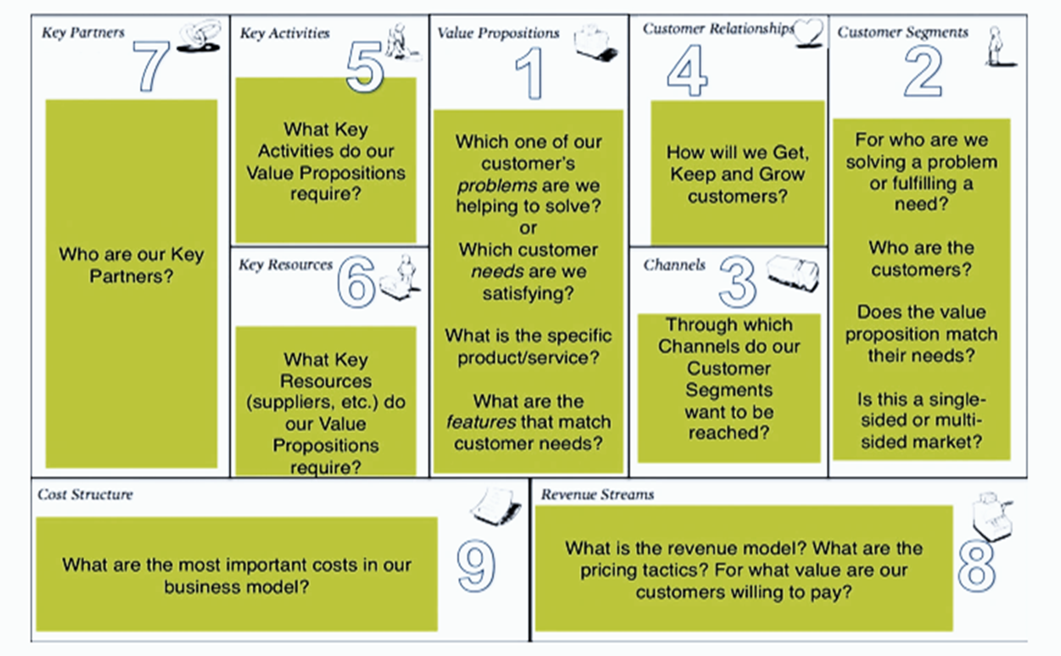
Business Model Canvas
https://canvanizer.com/choose-canvas
Notes:
This is a great tool from Osterwalder’s book “The Business Model Generation”. Start with #1 in the middle (Value Proposition) and discuss each box with the class. Use a company you are familiar with, or use an example like Uber from this module. This gives them another way to conceptualize their plan.

